Slide 1

Migrating Data using Polybase

Slide 2
Agenda
Tools of the Trade
Cloud vs On-Premise
Tools of the Trade (IDE)
SSMS
ADS
VS Code
Other
How to start writing code
Queries
Notebooks
Introduction to T-SQL
Database Objects
Working with data
Selecting
Filtering
Ordering
Grouping
Modifying
Multiple datasets
Working with Multiple datasets
Joining
SET Operations
Building processes
Views and Procedures
Data Modification
Analytical Functions

Slide 3




Tools of the Trade
Cloud
Someone else owns the hardware
On-Premise
You own the hardware

Slide 4
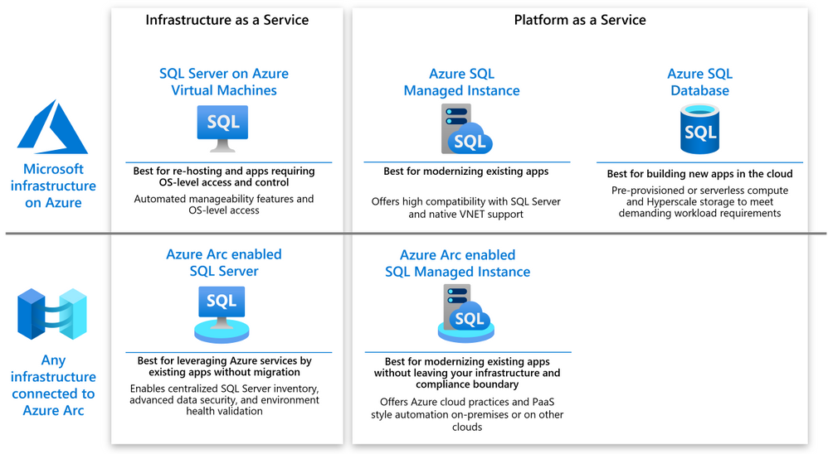
Azure DB offerings
https://tinyurl.com/hk7f6ujx

Slide 5




The Plan
Linked Server?
On-Premises SQL Server
Azure SQL Offerings
Azure BLOB Storage
https://tinyurl.com/hk7f6ujx

Slide 6
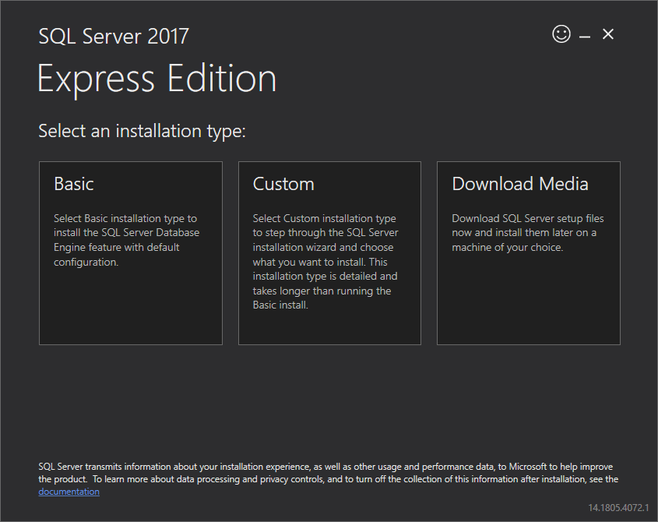
Tools of the Trade
Installing and Downloading
SQL Server Express
https://tinyurl.com/y6y8csu3
Editions
Express
Web
Standard
Enterprise
Developer
https://tinyurl.com/yzbvuyeb

Slide 7
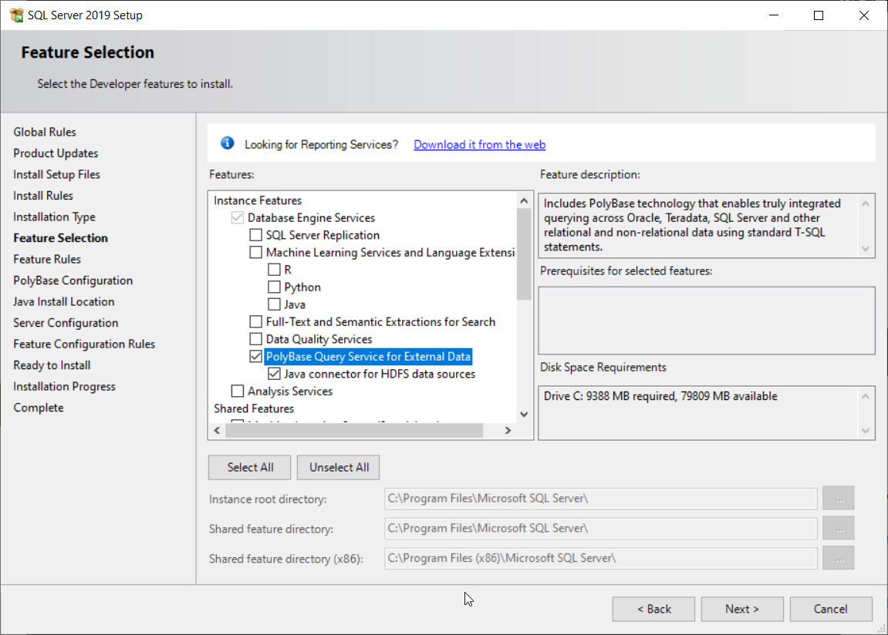
Preparing for Polybase
Installing and Downloading
SQL Server Express
https://tinyurl.com/y6y8csu3
Editions
Standard
Enterprise
Developer
https://tinyurl.com/yzbvuyeb

Slide 8
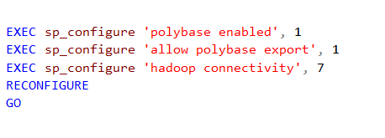
Preparing for Polybase
Make sure that mixed mode Authentication is enabled as well
https://tinyurl.com/a8uc7fd9
https://tinyurl.com/yzbvuyeb

Slide 9
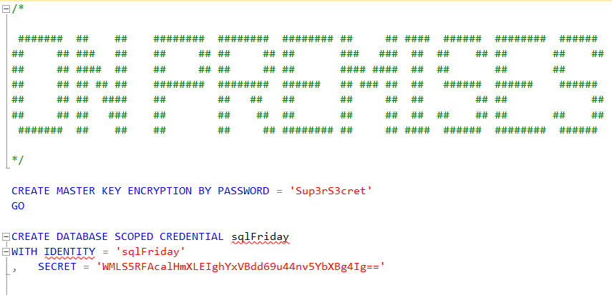
Authentication & Credentials
https://tinyurl.com/yzbvuyeb

Slide 10
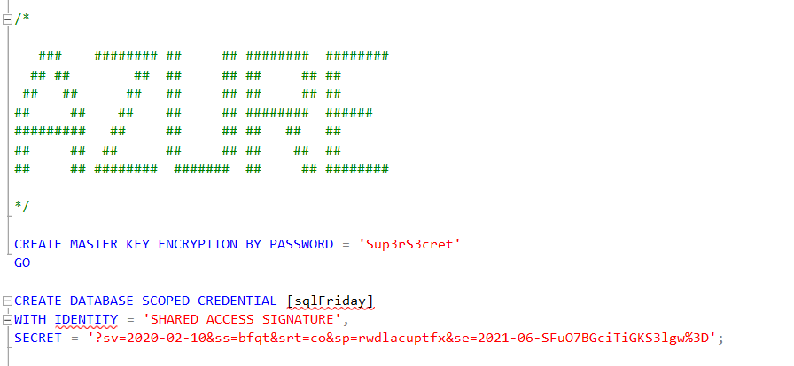
Authentication & Credentials
https://tinyurl.com/yzbvuyeb

Slide 11
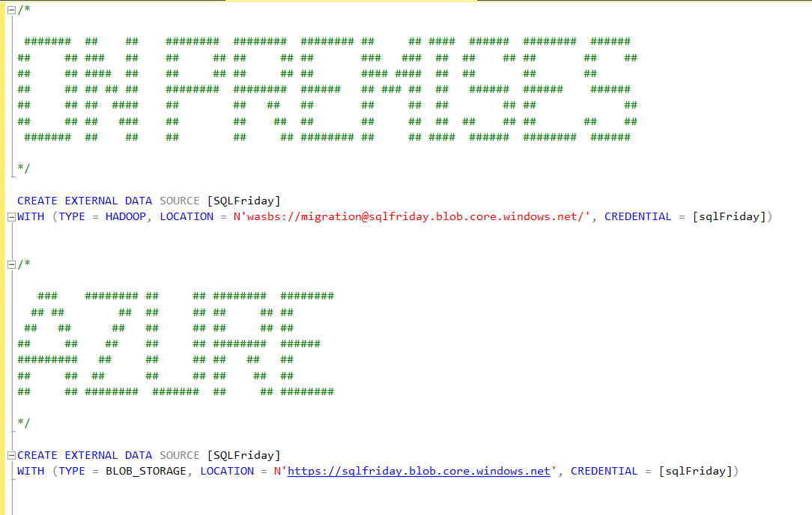
External Data Sources
Disclaimer
For Azure Synapse Dedicated Pools
And managed instance you can use HADOOP instead of BLOB_STORAGE
https://tinyurl.com/58ptfdzz
https://tinyurl.com/58ptfdzz

Slide 12
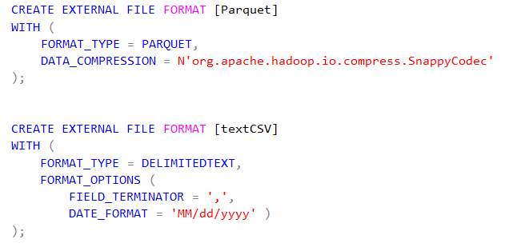
External File Formats
Formats
Delimited
ORC
Parquet
JSON
https://tinyurl.com/56zcddkz
https://tinyurl.com/56zcddkz

Slide 13
The Magic
Linked Server?
On-Premises SQL Server
Azure SQL Offerings
Azure BLOB Storage
https://tinyurl.com/hk7f6ujx

Slide 14
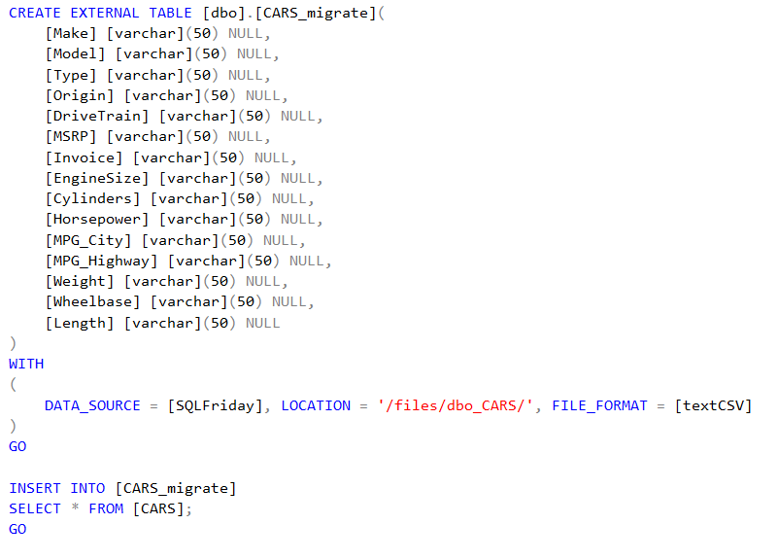
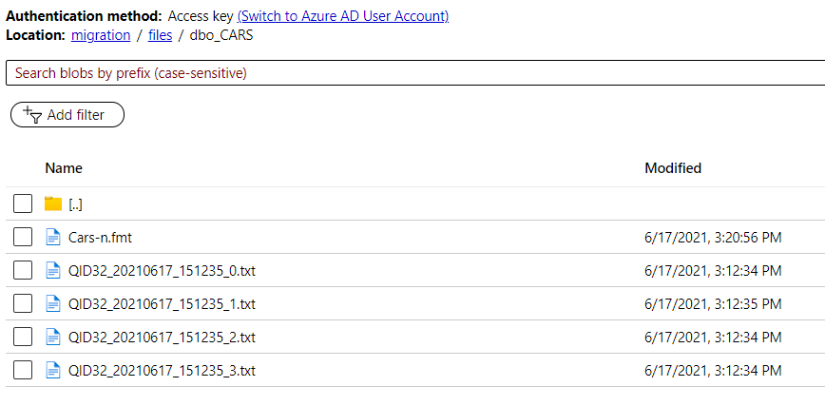
Create External Table
Process
Create External Table (schema)
Insert rows into External Table
https://tinyurl.com/56zcddkz
https://tinyurl.com/56zcddkz

Slide 15
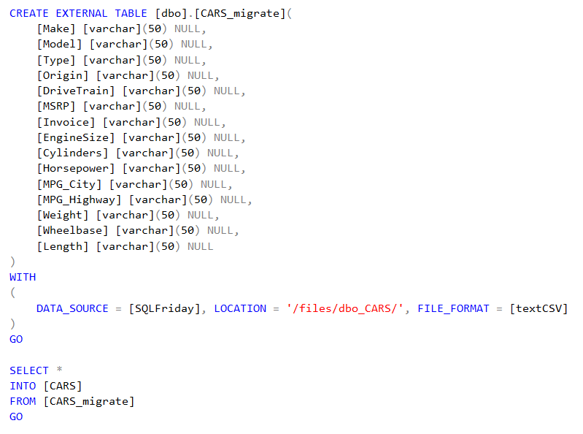
Create External Table
Process
Create External Table (schema)
Insert rows into External Table
https://tinyurl.com/56zcddkz
https://tinyurl.com/56zcddkz

Slide 16
Additional Resources
Red-gate University - https://github.com/LitKnd/TSQLBeginners
W3schools - https://www.w3schools.com/sql/default.asp
Datacamp - https://www.datacamp.com/courses/introduction-to-sql-server#!
TutorialRepublic - https://www.tutorialrepublic.com/sql-tutorial/
https://tinyurl.com/yjf2h9g6

Slide 17

Questions
https://blog.voogie.online

